Slide 1

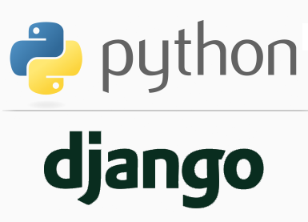
FULL STACK WEB DEVELOPMENT WITH DJANGO
Lecture 1

Slide 2

Today’s Agenda
What Is Python ?
Why To Use Python For Web Development ?
Pre-requisites For This Course
What Is Django ?
Front End V/s Back End
What Is Full Stack Development ?
History Of Django
Course Outline

Slide 3
What Is Python?
Python is a general purpose and powerful programming language.
It is considered as one of the most versatile programming language as it can be used to develop almost any kind of application including :
desktop application
web applications
network applications
data science applications
and many more.

Slide 4
Why Python ?
Python is one of the preferred languages for almost any kind of application (specially for web development ) because:
Code is easy to read and understand . No semicolons , no curly braces.
Quick development with much lesser code.
Strong developer community.
Very stable libraries and frameworks.

Slide 5
What You Should Know ?
To start learning Full Stack Development With Django , you must be familiar with following topics in Python:
Data types like List , String & Dictionary
Functions
OOP Concepts
Exception Handling
No knowledge of File Handling is required.
No knowledge of Database Programming is required
No knowledge of GUI is required.
No knowledge of any IDE is required as we will learn to use Microsoft’s VS Code from scratch.

Slide 6
What Is Django ?
Django is a free , open source , web application development framework written in Python.
To fully understand this definition we must discuss each of the words highlighted in blue color separately, which are:
Free
Open Source
Web Application
Framework

Slide 7
What Is Free And Open Source ?
Free , simply means that just like Python , we don’t have to pay anything for downloading and using Django , for non-commercial use.
Open Source means we can modify and share Django because it’s source code is publicly available.

Slide 8
What Is A Web Application ?
A web application which most of the non IT people refer to as a website , is a collection of web pages .
In technical terms , a Web application (Web app) is a program that executes on a server on the Internet and it’s output is delivered to the browser

Slide 9
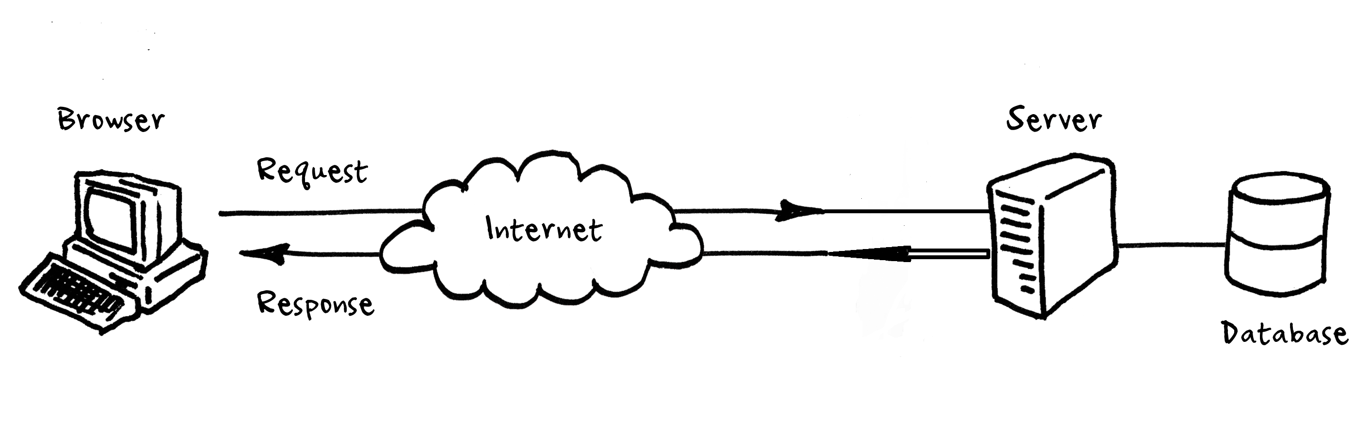
What Is A Web Application ?

Slide 10
What Is A Web Site ?
A website, is a set of web pages built using HTML, CSS, and JavaScript that contains static information in the form of text, images, audio, and video content.
Websites are generally meant to present information to visitors about a business , a person , an organization etc.
Examples of websites include News papers websites, tutorial websites ,personal websites etc.

Slide 11
Web Site V/s Web Application
Website | Web Application
Convey static information to the visitor i.e. every user sees the same information | Convey dynamic information to the visitor i.e. every user sees different information based upon his input
Provide a one-way communication where a user visits a website, goes through the information on a website and leaves | Provides a two-way interaction wherein a user performs certain actions on a web page which generates responses from the server.
Can be developed by simply using front-end technologies like HTML, CSS and JS | Alongwith front-end technologies they also require support of a backend technologies like Python, PHP, Java , Go, C# etc.
Examples are bhaskar.com, stroustrup.com , tutorialspoint.com etc | Examples are amazon.in, facebook.com , gmail.com etc

Slide 12
Web Application Architecture
A Web application is a complex piece of software.
It consists of many components like the user interface, a login-screen, a products display screen, the database, etc.
It’s actually easier to define web application architecture with the help of a diagram , present on next slide that shows how everything fits together

Slide 13
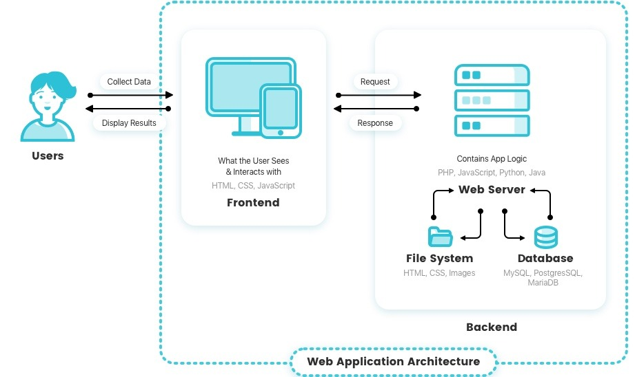
Web Application Architecture

Slide 14
Web Application Components
Every web application , primarily contains 2 very important components and these are called :
Front End
AND
Back End

Slide 15
What Is Front End ?
The front end , also called client side of a web application , is everything that the user sees and interacts within inside their browser.
It includes everything the user experiences directly: from text and colors to buttons, images etc.
The main purpose of the client side is to collect data from users.

Slide 16
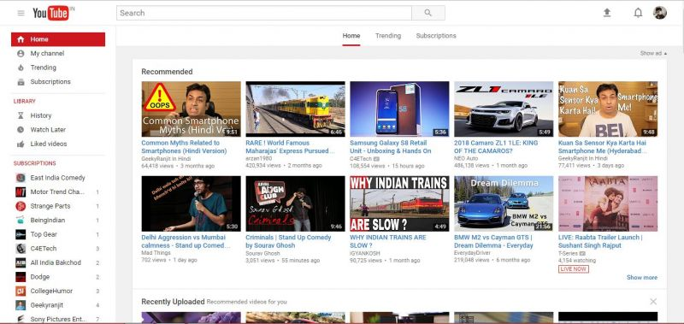
What Is Front End ?

Slide 17
What Is Front End Made Up Of ?
The front end is built with 5 key technologies :
HTML
CSS
JavaScript
Ajax
jQuery
The three very important of them are HTML , CSS and JavaScript

Slide 18
The Three Key Players In Front End
HTML (HyperText Markup Language)
CSS (Cascading Style Sheets)
JavaScript
It is the backbone of the Web. Every website you visit is built with HTML.
It takes care of all the structure and content
It is what controls the look and feel of the page.
CSS sets the colors, fonts, background images, and even the way the page
is laid out
It is a programming language commonly used to create interactive effects
within web browsers.

Slide 19
The Three Key Players In Front End
In short we can remember that:
HTML is for content
CSS is for presentation
JavaScript is for behaviour

Slide 20
What Is Back End ?
The backend (or “server-side”) is the portion of the website you don’t see.
It is in charge of calculations, business logic, database interactions etc
The backend communicates with the front-end, sending and receiving information to be displayed as a web page.

Slide 21
What Is Back End Made Up Of ?
A backend developer needs to understand 2 very important elements :
A server side programming language like Python , Java, PHP , Ruby, C# etc
AND
Database Management System like Oracle, MySQL etc.

Slide 22
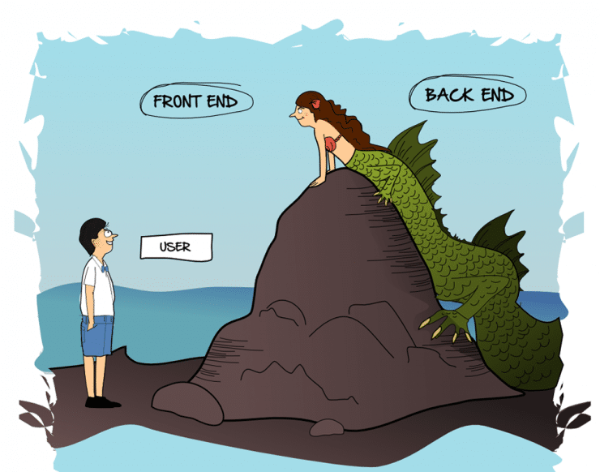
Front End V/s Back End

Slide 23
What We Will Learn ?
We will learn both Front End Technologies as well as Back End Technologies as a part of this course.
And that’s why it is called FULL STACK WEB DEVELOPMENT.

Slide 24
What Full Stack Web Development Contains ?
Full stack developers work with both the front and back end of a web application.
They’re familiar with HTML, CSS, JavaScript and one or more back end language/framework which in our case are Python and Django.

Slide 25
What Is A Web Application Framework ?
Now the last term in Django’s definition is web application framework . So let’s understand it
A web application framework is a set of tools which can be used to develop websites and web applications .
These tools help us develop these applications in a faster and easier way.

Slide 26
What Is Meant By Tools ?
When we're building a webapp, we always need a similar set of components like:
A way to handle user authentication (signing up, signing in, signing out)
A way to interact with the user like HTML forms
Allowing users to upload files, etc.
An admin panel for our webapp
Luckily for all these activities Django gives us ready-made components to use.

Slide 27


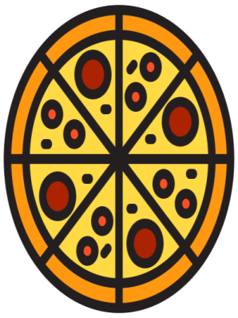
A Real Life Example
Imagine , a chef needs to bake a Pizza . Think , how he would go for it ?

Slide 28
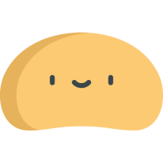
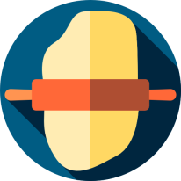



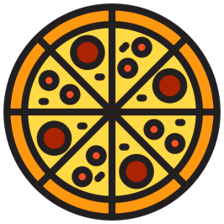


Making A Pizza
Stretch it using
rolling pin
Cut it using
pizza cutter
Prepare a dough
These are like tools
Job done!
Bake it in an oven

Slide 29
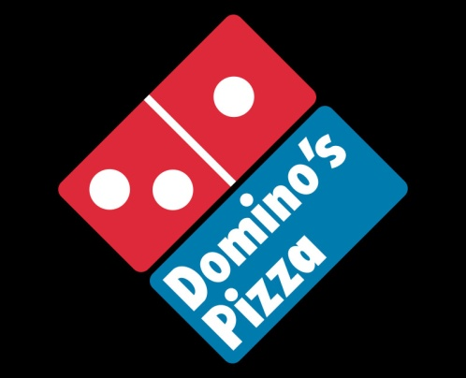
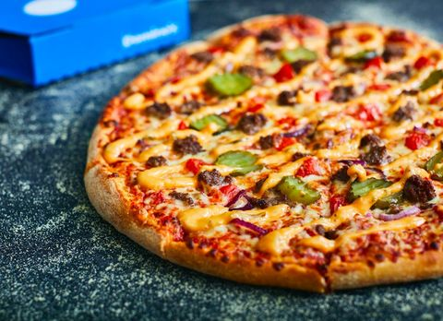
A Real Life Example
Now , just imagine , how DOMINOS makes Pizzas ?

Slide 30
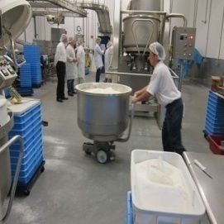
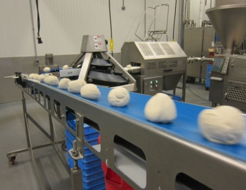
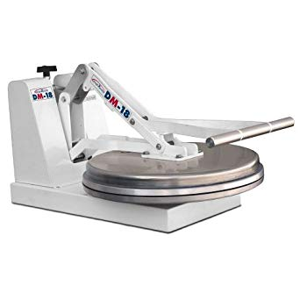

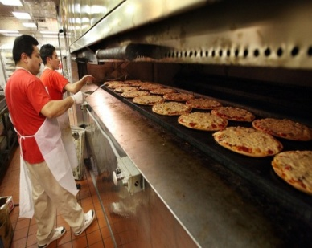

Dominos Pizza Making
Put ingredients in a
Dough machine
Dough Machine will produce dough balls
Stretching & cutting using pizza cutter machine
This Pizza Factory is a
Framework
Job done!
Bake in Pizza oven

Slide 31
What Tools Django Provides?
Following are the tools provided by Django that help our web application building easier and rapid:
User Management : For handling user login/authentication
ORM : For handling database related code
HTML Templating : For generating dynamic HTML
Form Handling : For accepting user inputs
Url Routing : For transferring request to correct web page
And many more. . .

Slide 32
History Of Django
Started as an internal project at the Lawrence Journal-World newspaper at Lawrence, Kansas, in the United States in 2003.
In 2005, Django was released it to the public as an open source project

Slide 33


Who Developed Django ?
The credit of developing Django goes to Adrian Holovaty and Simon Willison who developed the initial version of Django at the Lawrence Journal-World newspaper.
Adrian Holovaty
Simon Willison

Slide 34
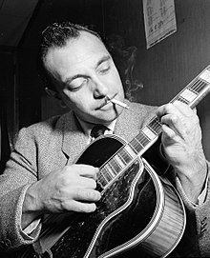
How Django Got It’s Name ?
The name Django is given after a French guitarist Django Reinhardt.
This is because both Willison and Holovaty are big fan of Django Reinhardt

Slide 35
Django In 2022
As of now, i.e in 2020 – the Django framework operates under the guidance of the Django Software Foundation (DSF).
Now Django has
Over 1000 contributors
More than 18 release versions. Current latest is 4.0.4
Over 3000 packages specifically designed to work with the Django framework
It’s official website is https://www.djangoproject.com/

Slide 36
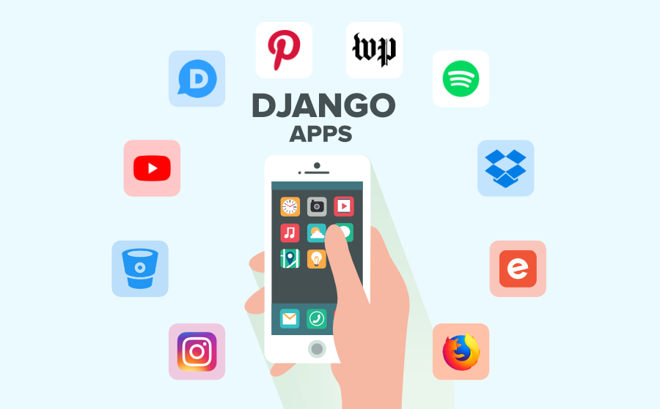
Famous WebApps Developed Using Django

Slide 37
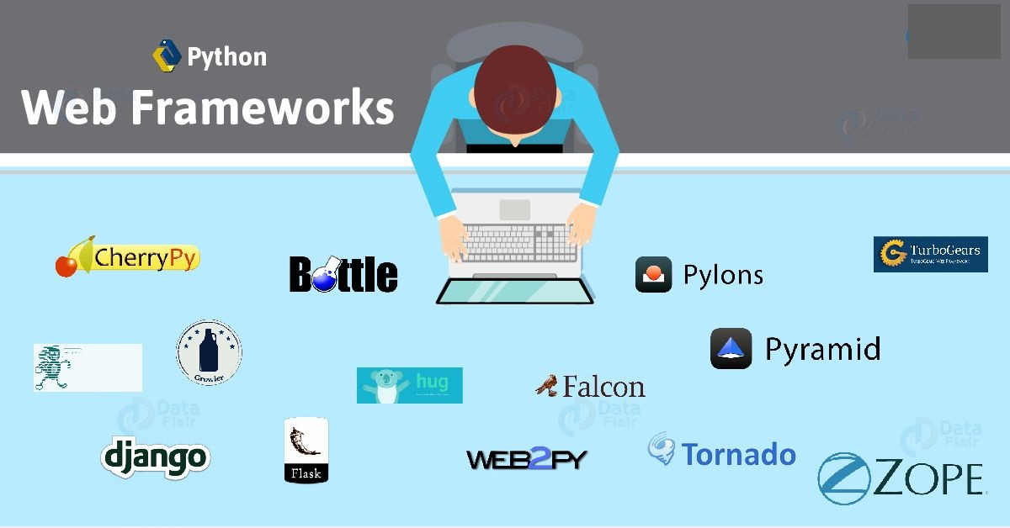
Alternates To Django

Slide 38
Course Outline
As mentioned before this is a FULL STACK DEVELOPMENT COURSE, so you will learn both front end and back end technology stack:
Front End | Back End
HTML | Django Models | Django Forms
CSS | Django Views | Model Forms
JavaScript | Django Templates | URL Routing
DOM | ORM | Administration
Ajax + jQuery | User Management

Slide 39
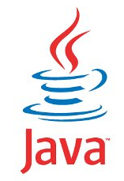
Next Class. . .
The next class is on Friday , 19th Nov @ 9:00 PM
Topic: HTML
For any query ,please call at 7870554215,9826686245.

Slide 40

Course Fee

